Slide 1
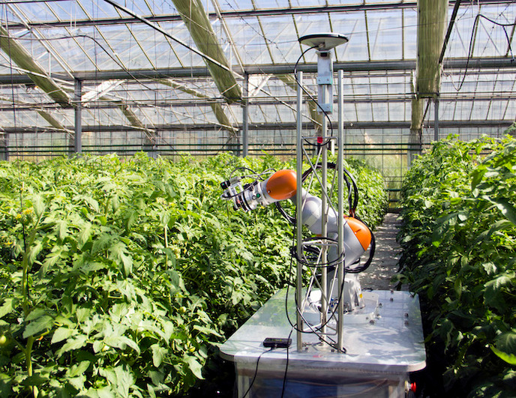
Pest Monitoring in Greenhouses Using Vision Technology
Optimizing Pest Control through Automated Visual Detection
Submitted by:
Submitted to:
Kirti Ma’am
Harshita
Bhawna chaudhary

Slide 2
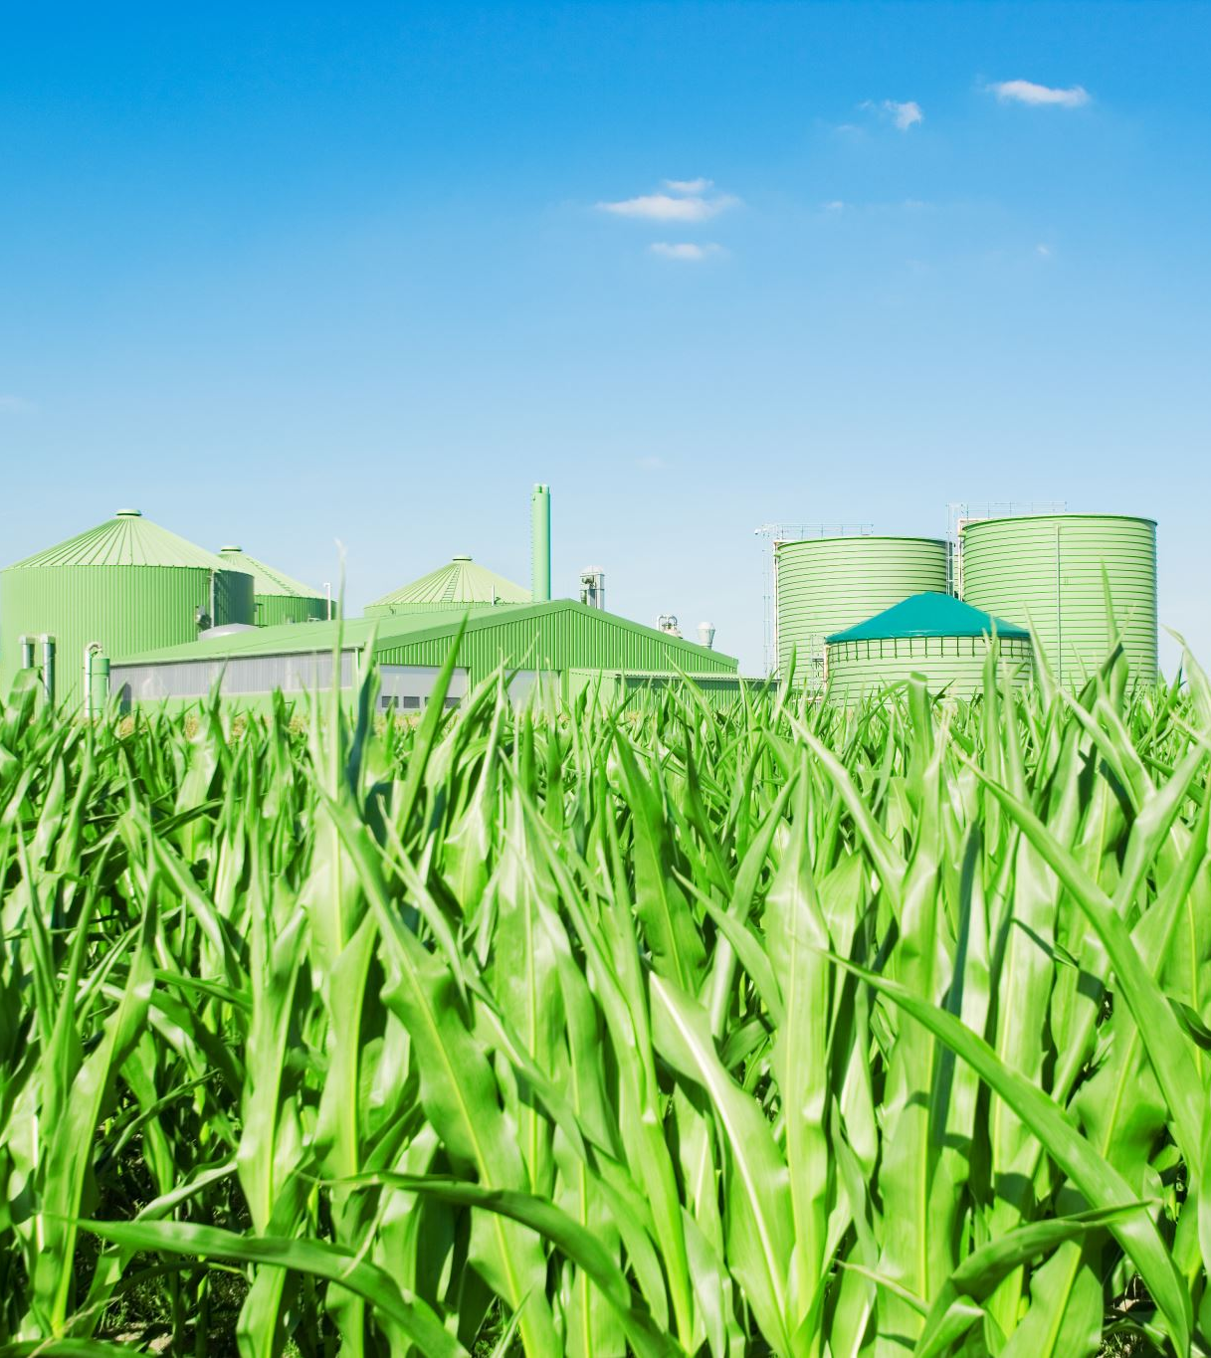
Introduction & Background
Background:
Greenhouses require effective pest control to protect crops and maintain yield.
Traditional pest control relies on manual monitoring, which is time-consuming and error-prone.
Problem Statement:
Manual inspection is inefficient and may miss early-stage invasion.
Objective:
Develop an automated, vision-based system for real-time pest detection that optimizes pest management strategies.

Slide 3

Motivation & Research Significance
Motivation:
Enhance yield by reducing crop damage from pests.
Lower costs and minimize environmental impact by reducing excessive pesticide use.
Significance:
Early and accurate detection enables prompt action and integrated pest management.
Supports sustainable agriculture by enabling precise, data-driven pest control.
Key Contributions:
Implementation of a deep learning model using an open-source IP02 dataset from Kaggle.
Integration of data augmentation, transfer learning, and evaluation metrics to achieve robust pest detection.

Slide 4

Literature Review & Related Work
Related Methods:
Manual pest inspection and traditional image-based techniques.
Previous computer vision approaches in agriculture with limited real-time application.
Identified Gaps:
Insufficient accuracy in dynamic greenhouse environments.
Lack of robust, scalable real-time detection systems.
Our Approach:
Leveraging state-of-the-art deep learning (MobileNetV2) with transfer learning on the IP02 dataset.
Addressing limitations through comprehensive data augmentation and model optimization.

Slide 5

Dataset Overview
Dataset Source:
IP02 dataset from Kaggle.
Dataset Structure:
Three main folders: train, val, and test.
Each folder contains around 100 directories corresponding to 102 pest classes.
Data Details:
Each class has 100+ images with varied conditions (lighting, angles, occlusion).
Provides a challenging yet comprehensive resource to train and validate a robust model.

Slide 6
Methodology & System Architecture
Project Workflow:
Data Collection: Acquisition of images from the IP02 dataset.
Data Preprocessing: Resizing, normalization, and augmentation (flip, rotation, zoom).
Model Training: Use of transfer learning with MobileNetV2.
Evaluation: Analysis using training/validation curves, confusion matrix, and classification report.
Deployment: Saving the trained model for real-time pest monitoring.

Slide 7
Model Architecture & Implementation
Model Overview:
Base Model: MobileNetV2 pre-trained on ImageNet (feature extractor).
Custom Layers: Global average pooling, dropout (0.2), and dense softmax layer for 102 classes.
Training Specifications:
Input Size: 224×224 pixels
Loss Function: Categorical Crossentropy
Optimizer: Adam (Learning Rate: 0.001)
Epochs: 5 (adjustable)
Batch Size: 32
Implementation Highlights:
Data augmentation is applied during training to improve generalization.
The base model’s weights are frozen to leverage ImageNet features.

Slide 8
Results & Evaluation
Performance Metrics:
Training and Validation Accuracy/Loss: (Show line graphs from model training.)
Test Accuracy: 53%
Test Loss: 1.92
Visual Evaluation:
Confusion Matrix: Highlights class-wise performance.
Sample Predictions: Correct vs. misclassified examples.
Key Observations:
High detection accuracy will be achieved for most pest classes, with a few challenging cases, if we run for more epochs
Data augmentation and transfer learning significantly improved performance.

Slide 9
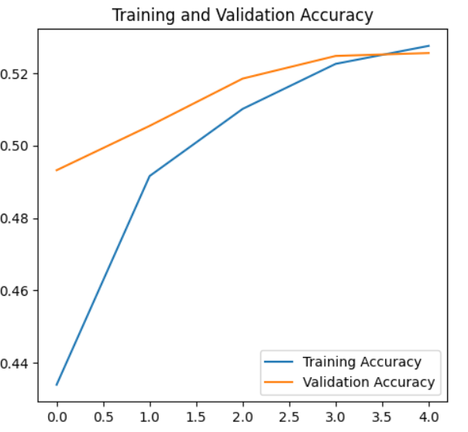
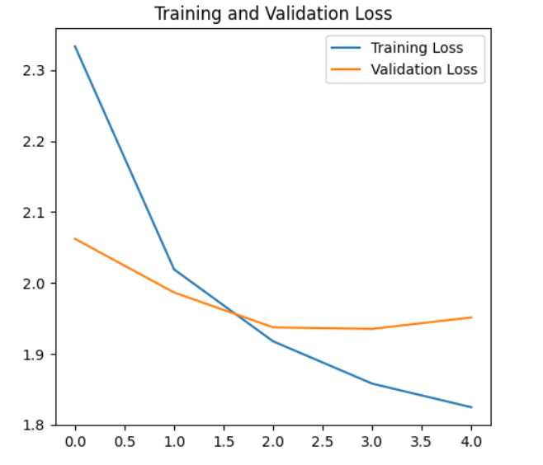

Slide 10
Discussion & Future Work
Discussion:
Challenges: Variations in image quality, similarities between pest classes, and limited real-time testing.
Model Limitations: Misclassifications in visually similar pest classes and low-light conditions affecting performance.
Future Work:
Fine-tune the model with additional hyperparameter optimization.
Integrate real-time video analysis for continuous monitoring.
Incorporate complementary sensor data (temperature, humidity) for multi-modal analysis.
Potential Impact:
Enhances precision agriculture by enabling smart, automated pest control.
Provides a scalable solution adaptable to different crop types and environmental conditions.

Slide 11
Conclusion
Conclusion:
Presented a vision-based system leveraging deep learning for pest monitoring in greenhouses.
Demonstrated the effectiveness of transfer learning with the MobileNetV2 model on the IP02 dataset.
Highlighted the potential benefits: improved detection accuracy, reduced manual labor, and sustainable pest management.
Next Steps:
Further model optimization and real-time deployment testing.
Exploration of multi-sensor integration for enhanced performance.

